Slide 1

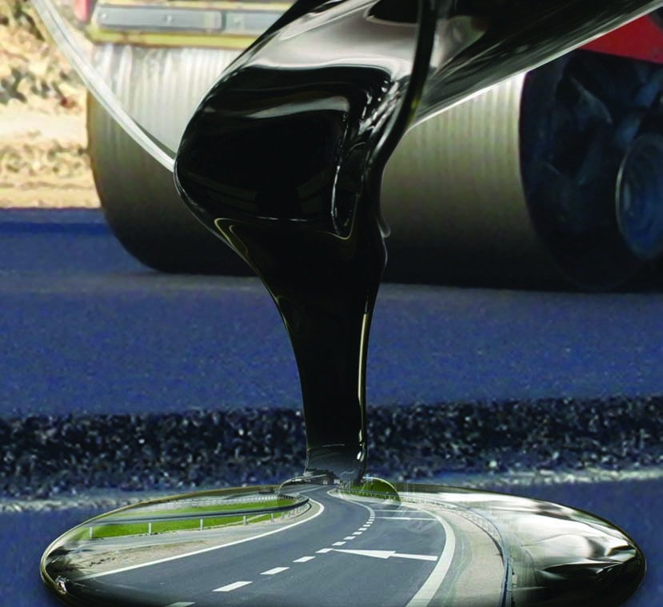

COMPANY PROFILE
SUGGESTED SERVICES :
Import & Supply of Bulk | Drum Bitumen & Bituminous products.
OVER 20 YEARS IN BITUMEN BUSINESS HANDLE, TRADING 51,224 MT BITUMEN IN BUSINESS YEAR 2018-19
www.omnipotent.co.in

Slide 2
CONTENT
INTRODUCTION & MANAGEMENT PROFILE
ORGANISATION STRENGTH
VISION & MISSION
USP OF THE COMPANY
GROUP COMPANY
CATEGORIES OF BITUMEN
OUR PRODUCT, SERVICES & SUPPLY
BITUMEN GRADE SPECIAFICATION
CRUDE OIL PRICE TREND
CONTACT US

Slide 3



INTRODUCTION & MANAGEMENT PROFILE
With focus on new ideas & innovation in Bitumen Industry The Omnipotent Industries Pvt Ltd. was established in Mumbai in 2016 to carry on the existing bitumen business of Global Enterprises & it’s Organization. The group has vast experience & expertise of more than 20 years in Bitumen industry headed by Mr. Prince P. Shah - Founder & Managing Director of Omnipotent Industries Pvt. Ltd. & transitioned Global enterprises a proprietory firm into Omnipotent - A Team single handedly looking into all dimensions of Bitumen business with dedicated expertise.
Omnipotent is the Customer oriented organization. The company is working for reliability & is incubating exciting business models & proposals to its customers. Our branches have tie-ups with manufacturing company for job work & supply of Bituminous products.,
Our Branches & JV’s at :
Mumbai, Delhi, Ahmedabad, Chennai, Bangalore, Indore, Ernakulam, Hyderabad, Mangalore, Kolkata.
ISO 9001 2008

Slide 4
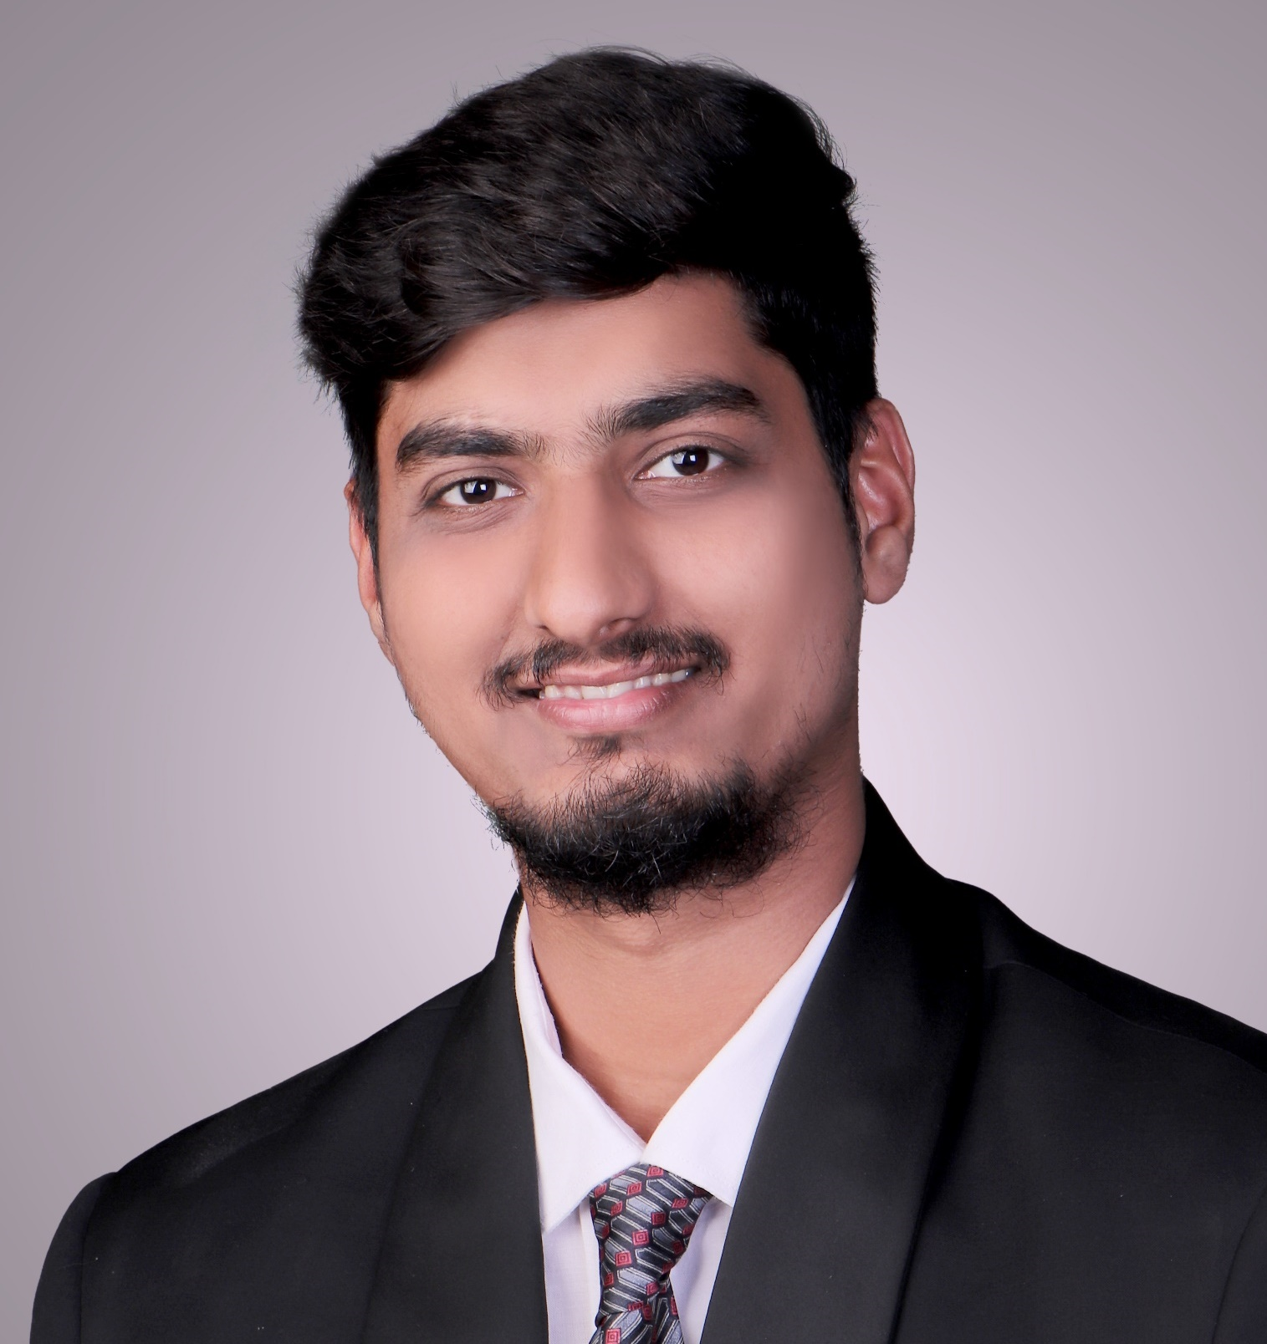
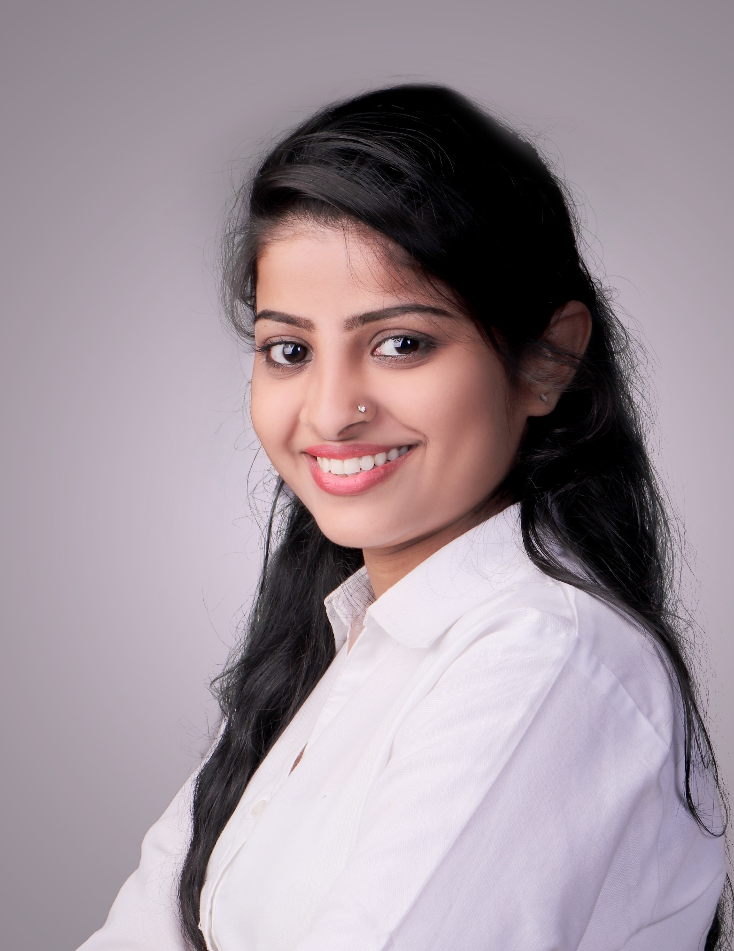
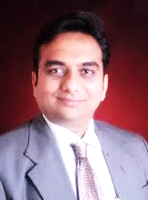
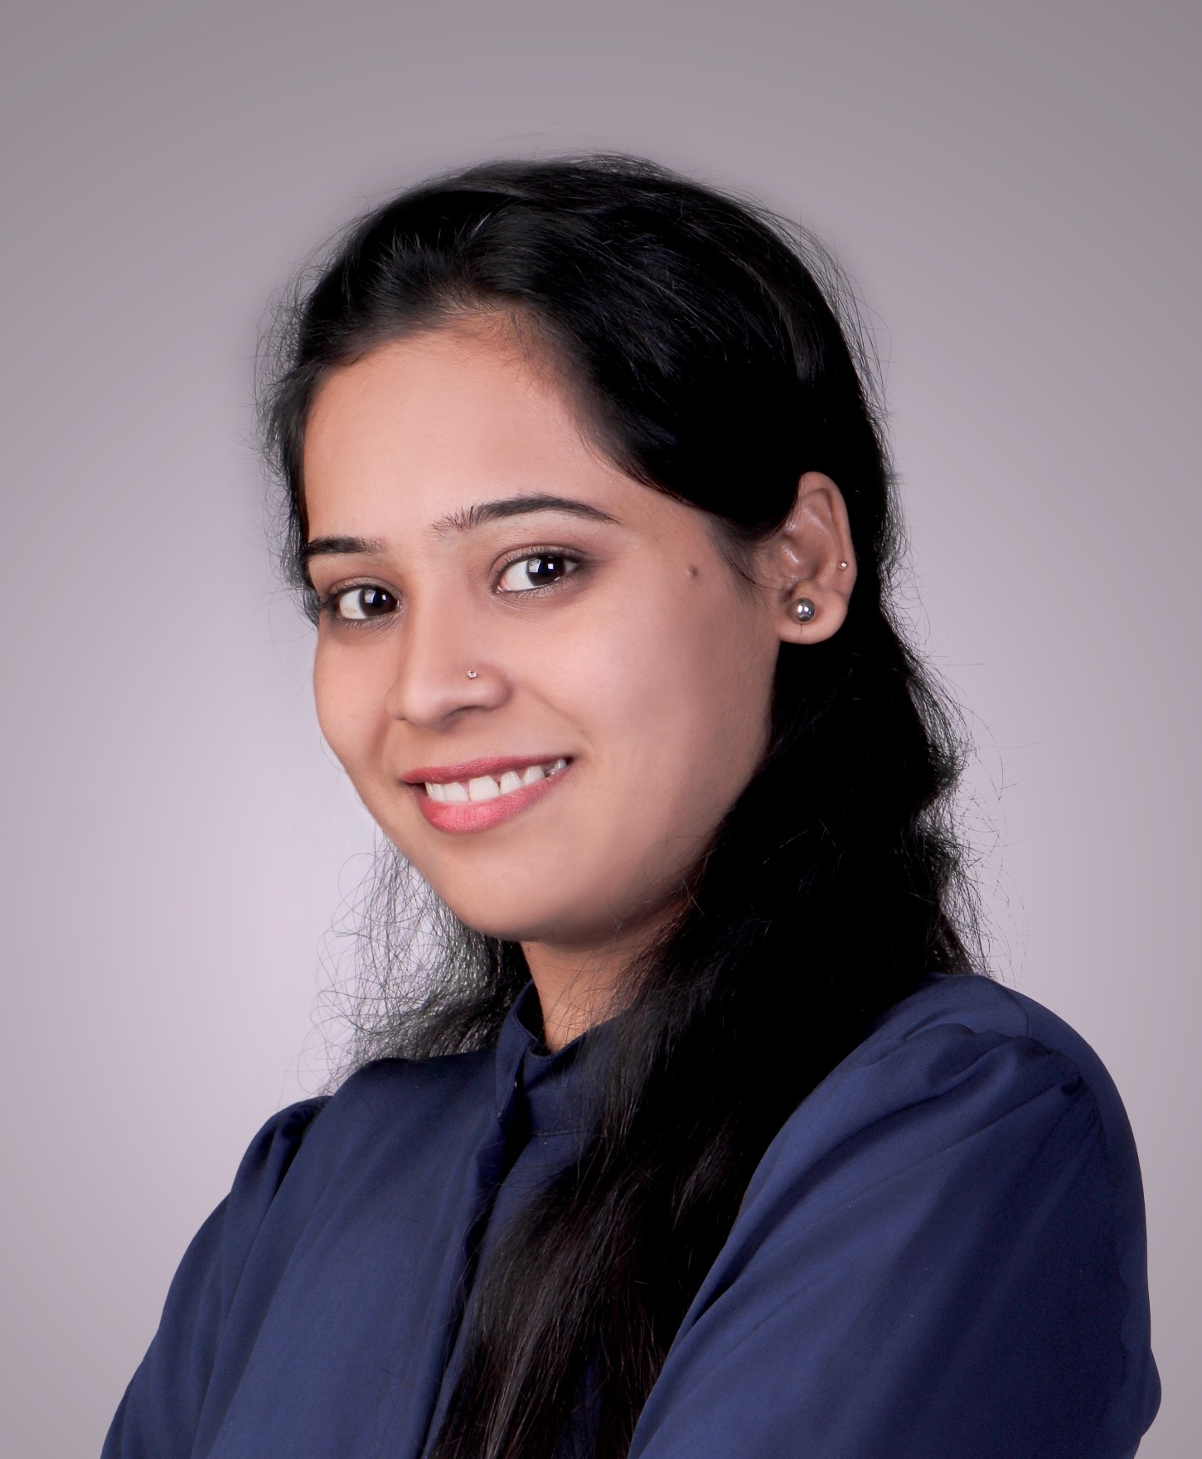
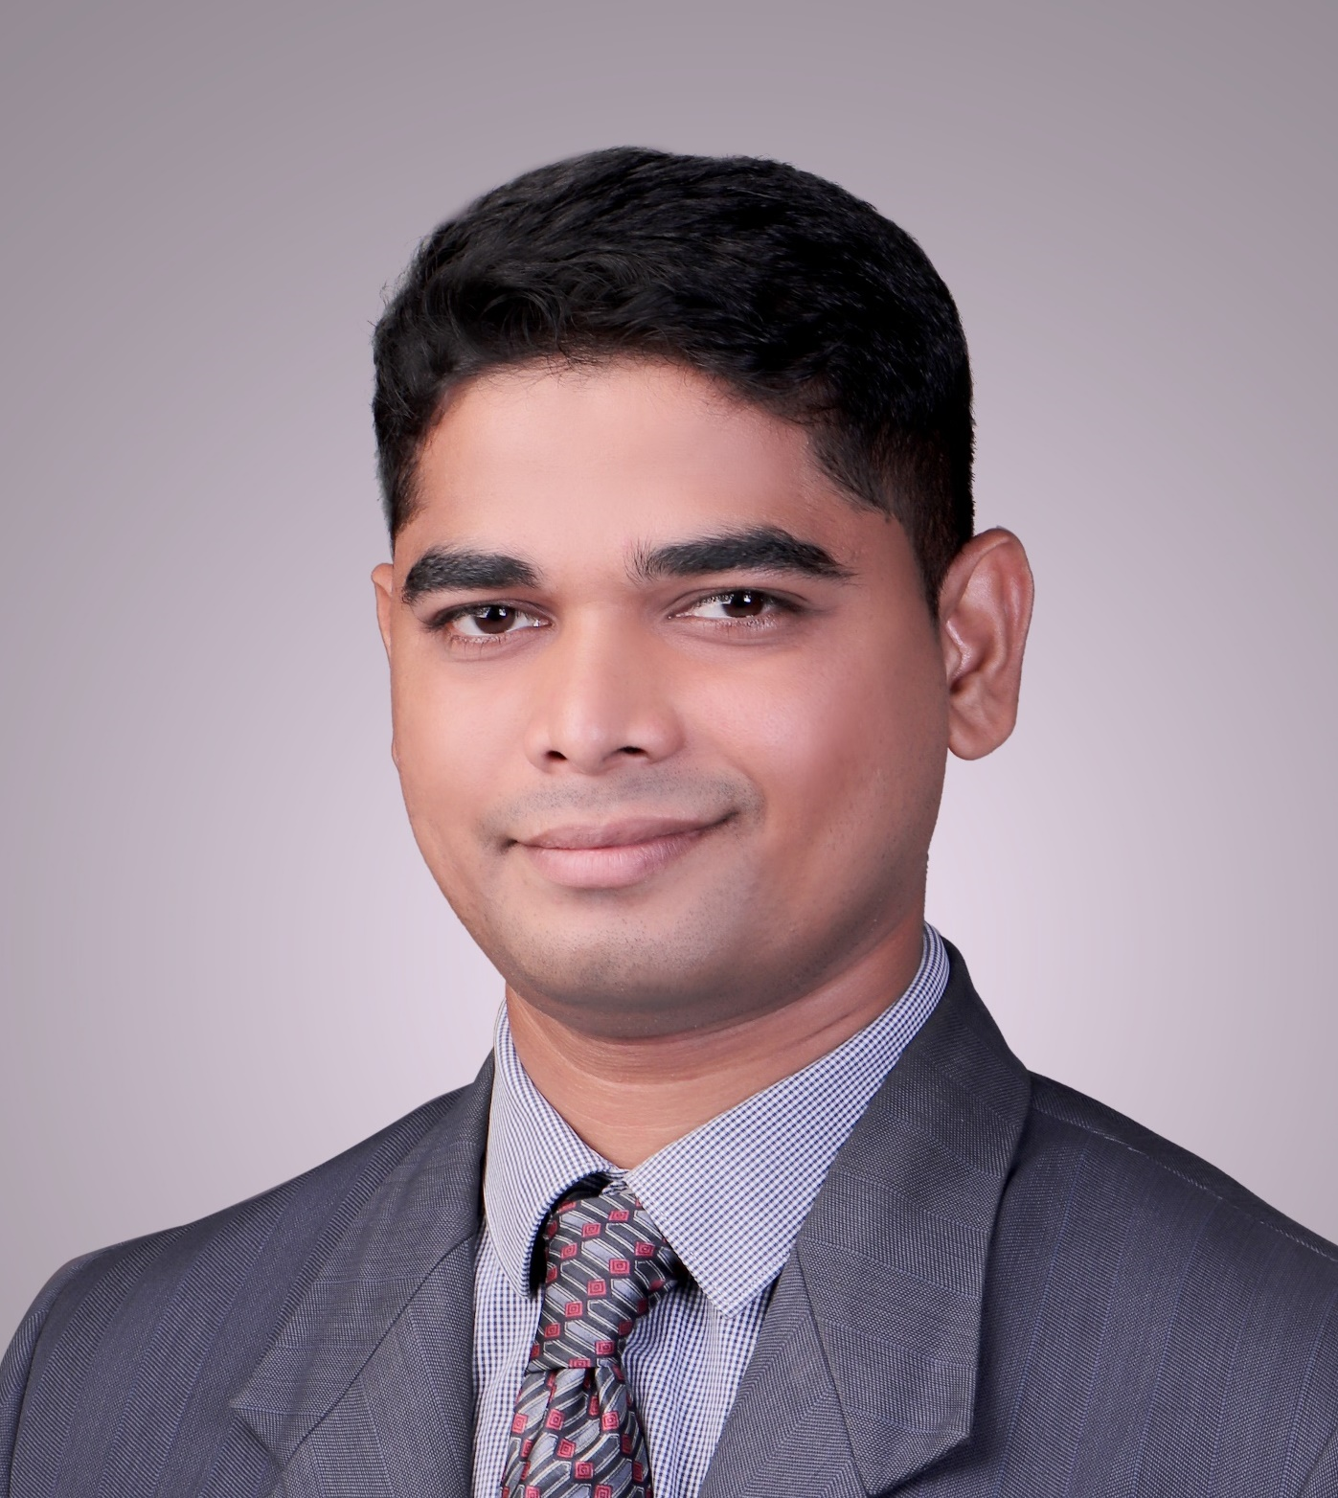
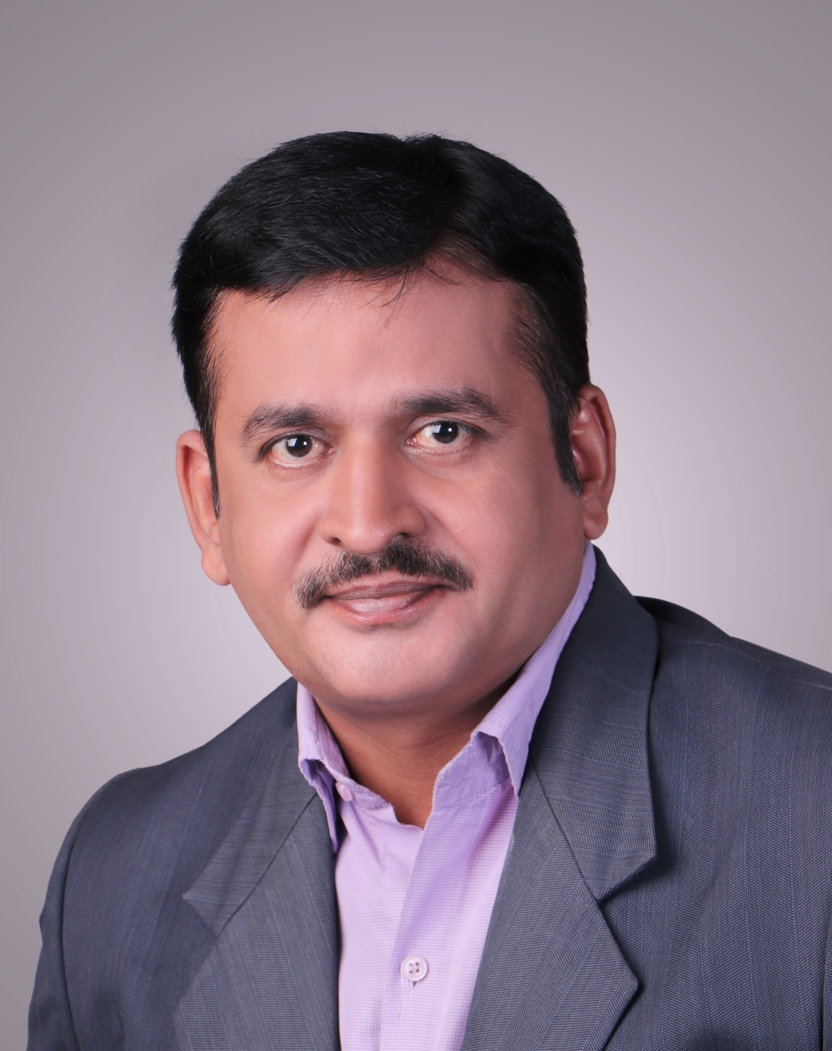
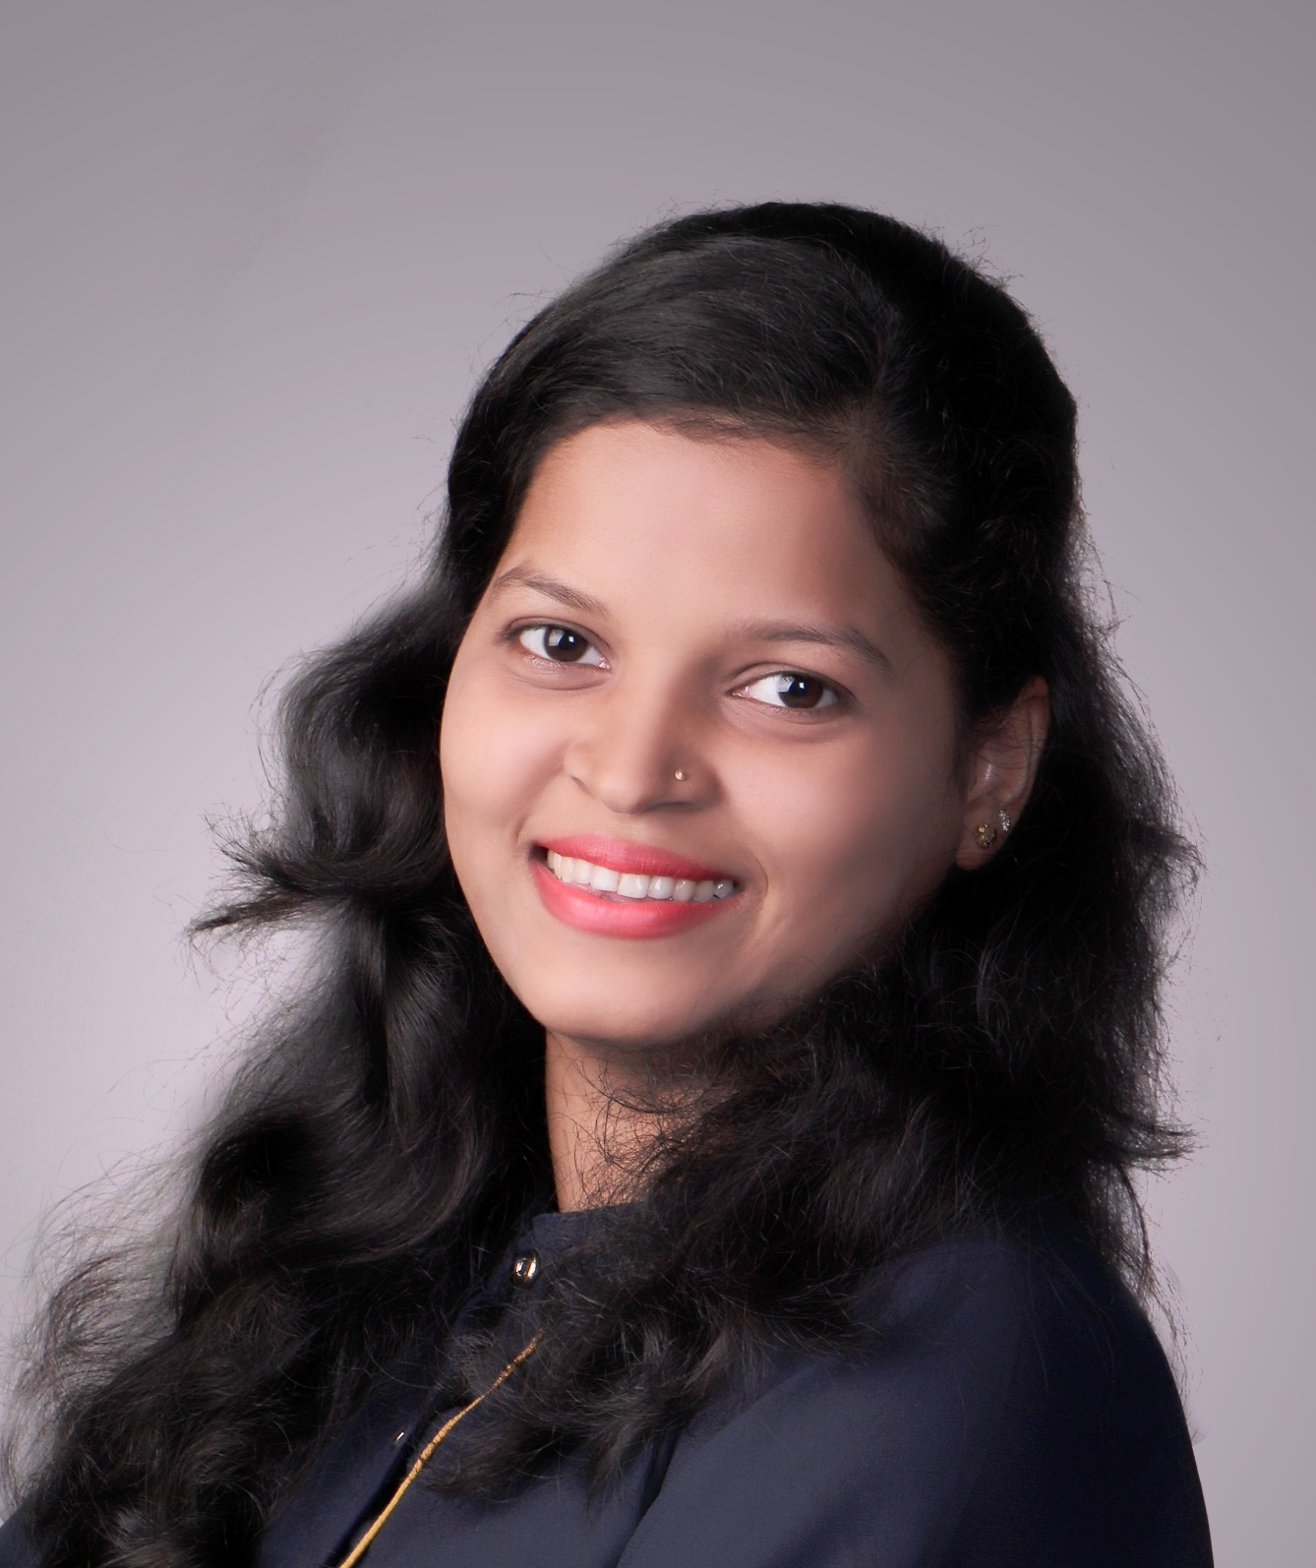
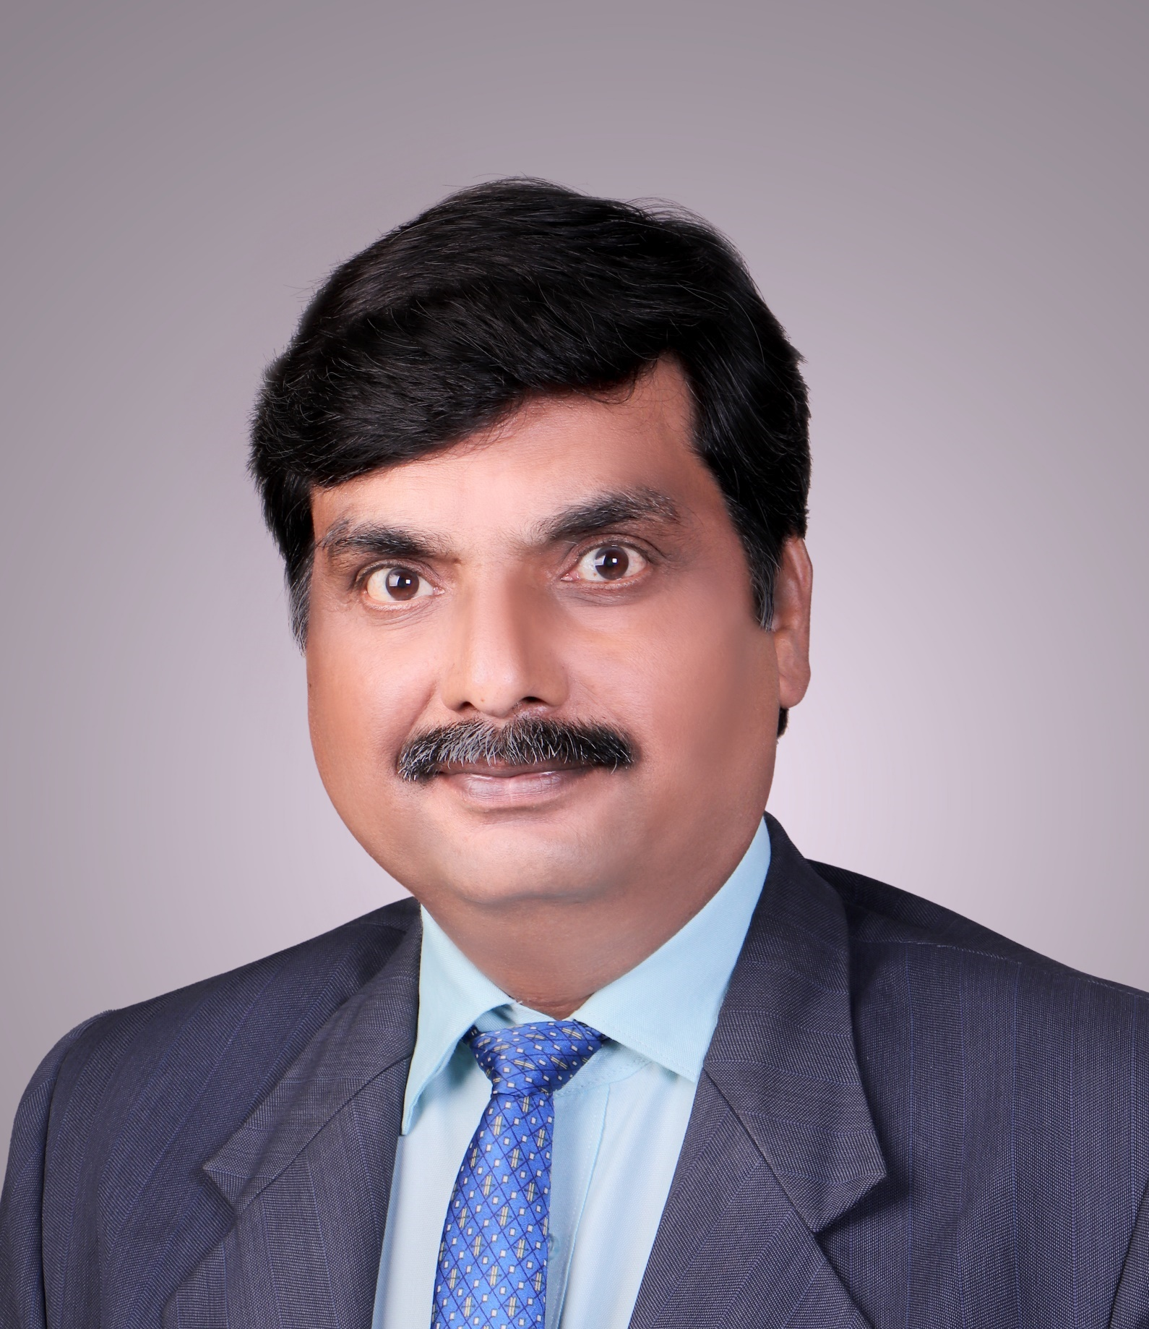
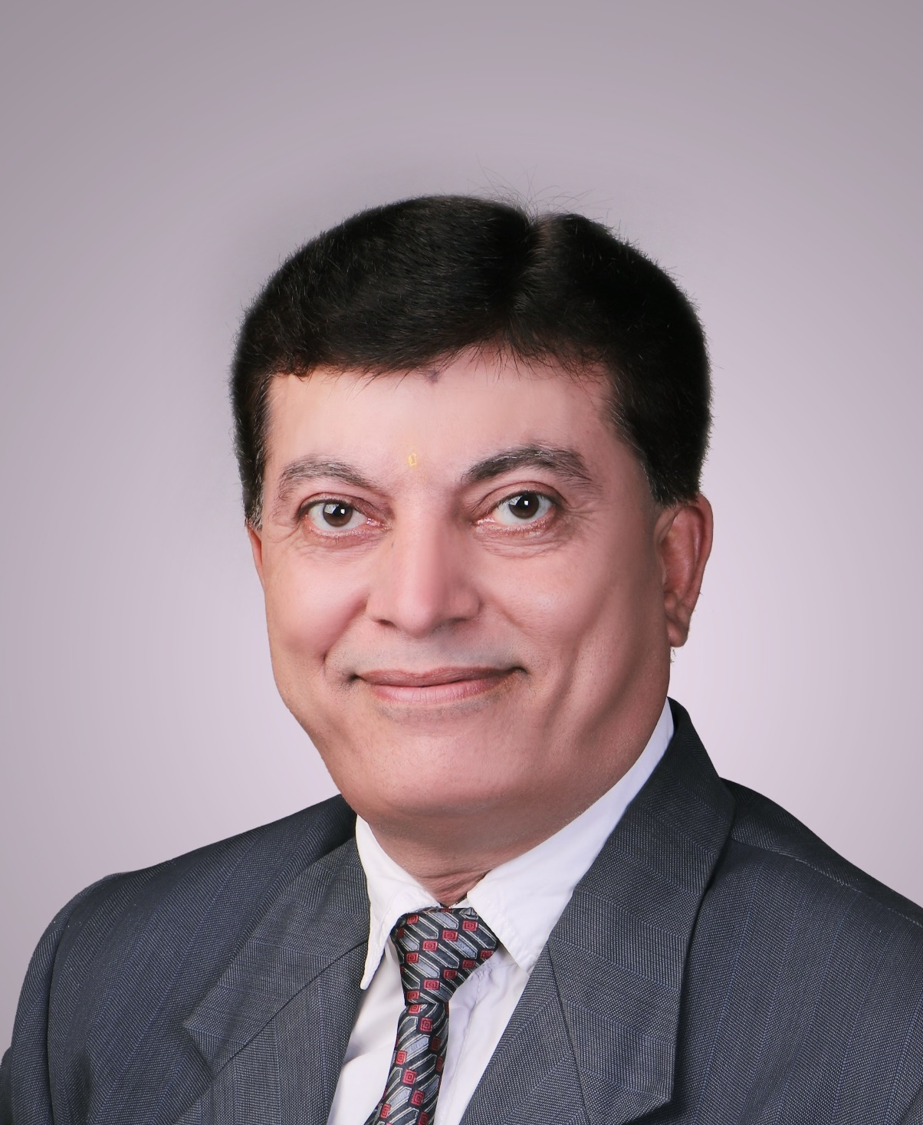
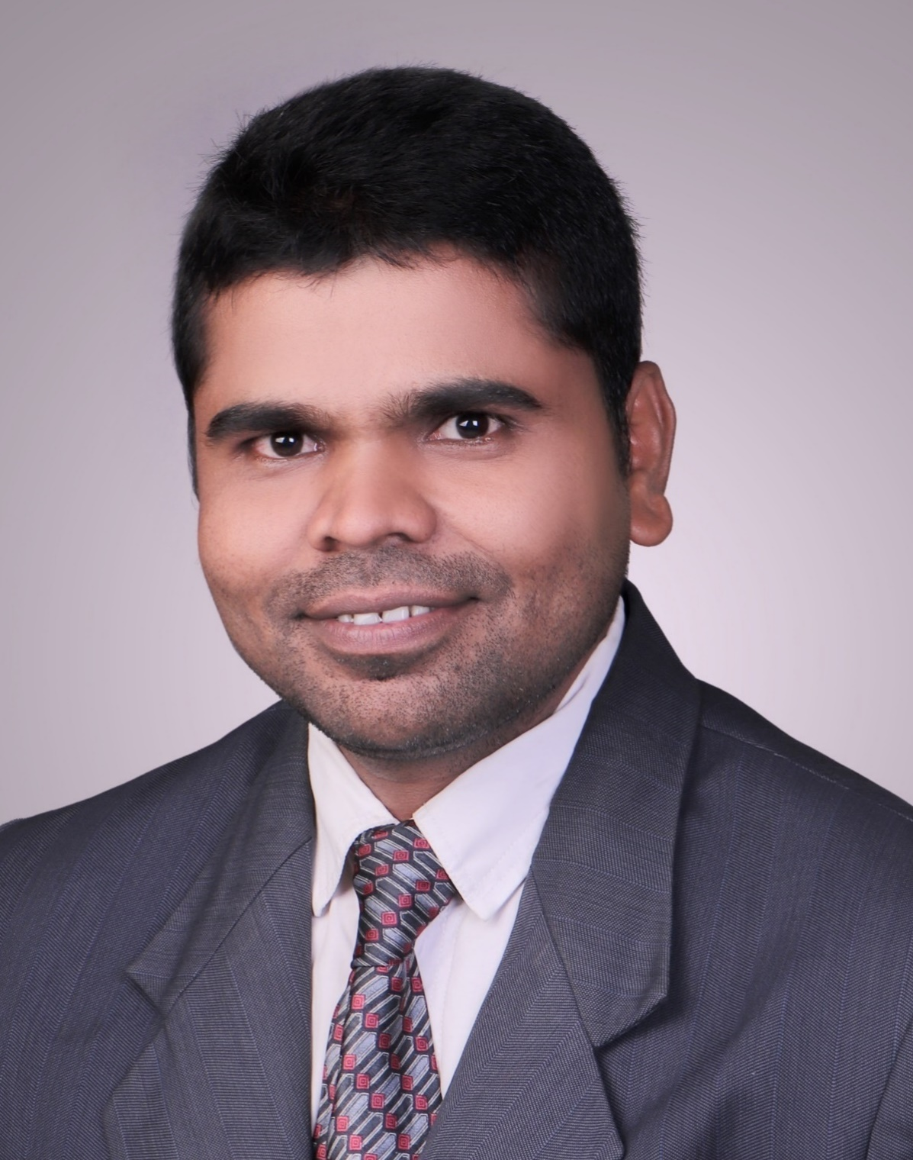
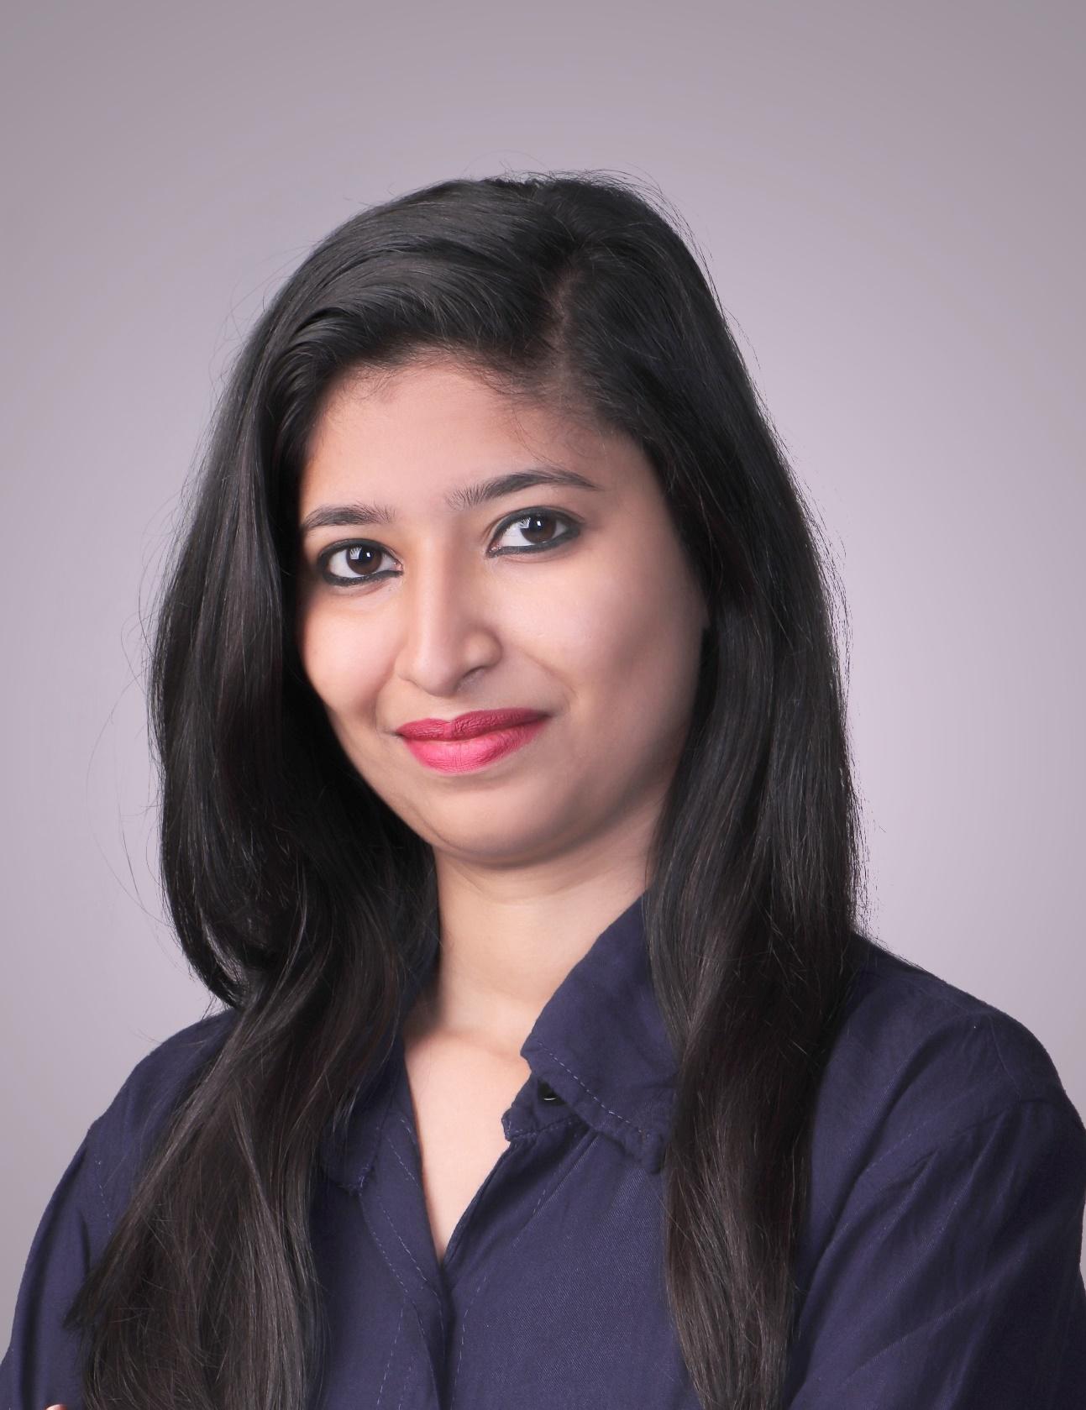
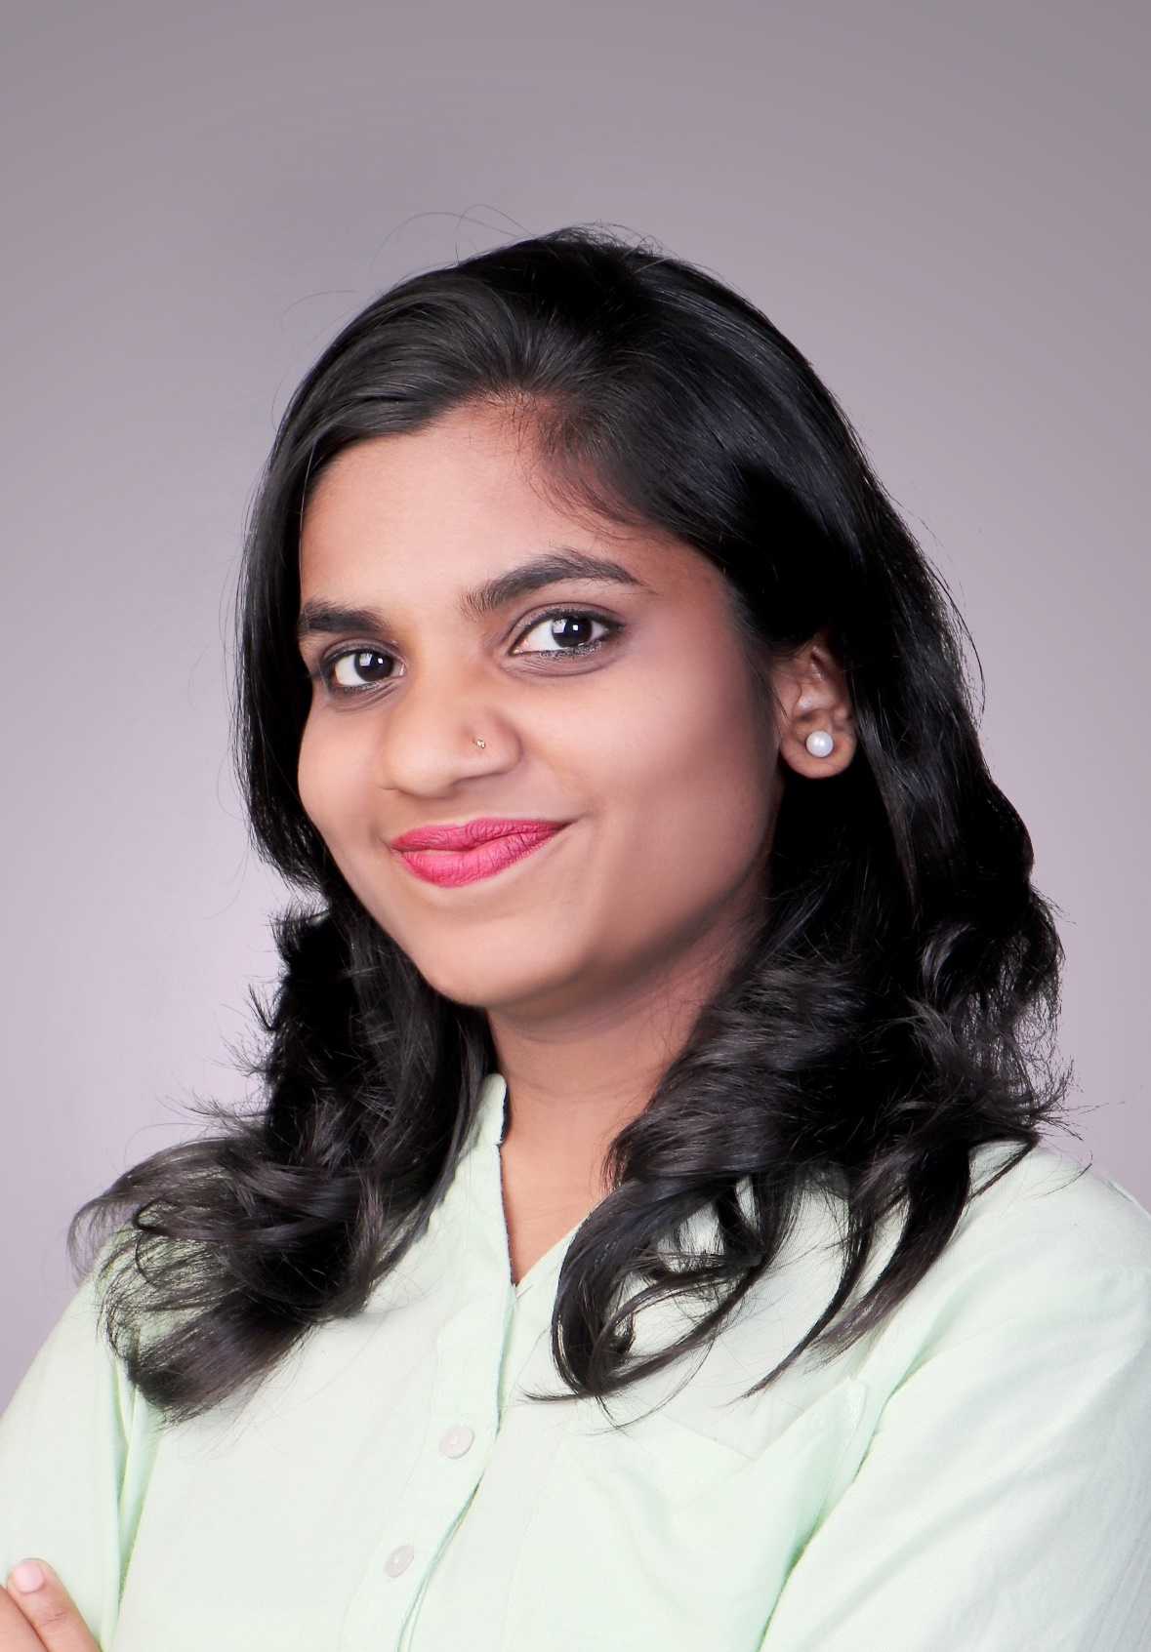
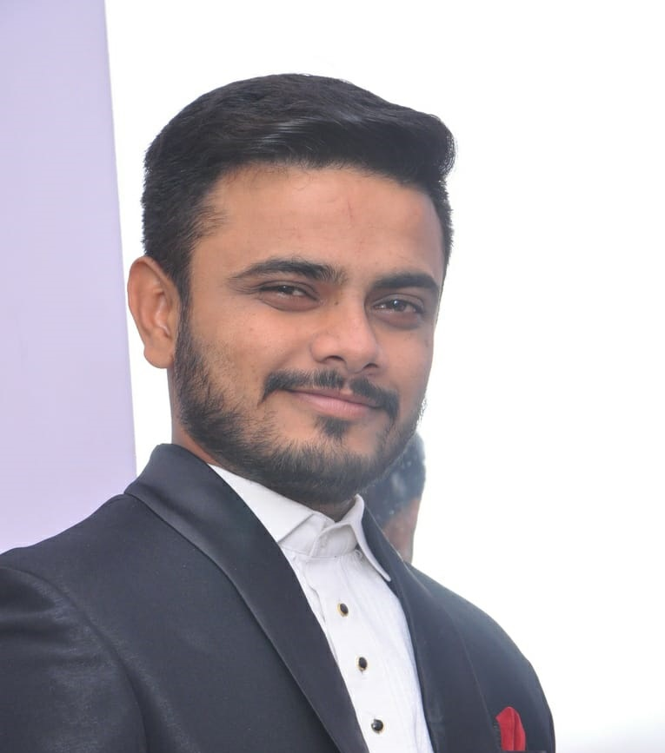
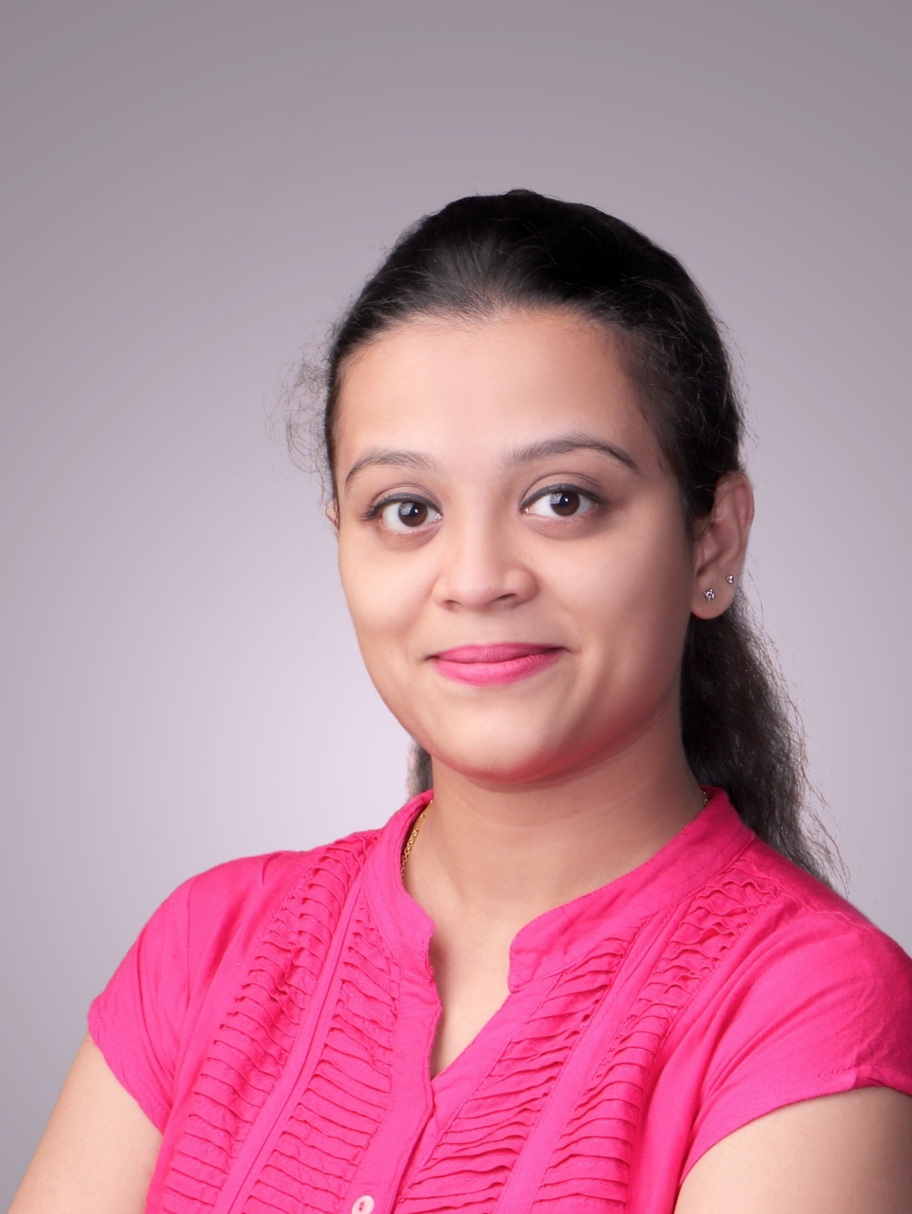
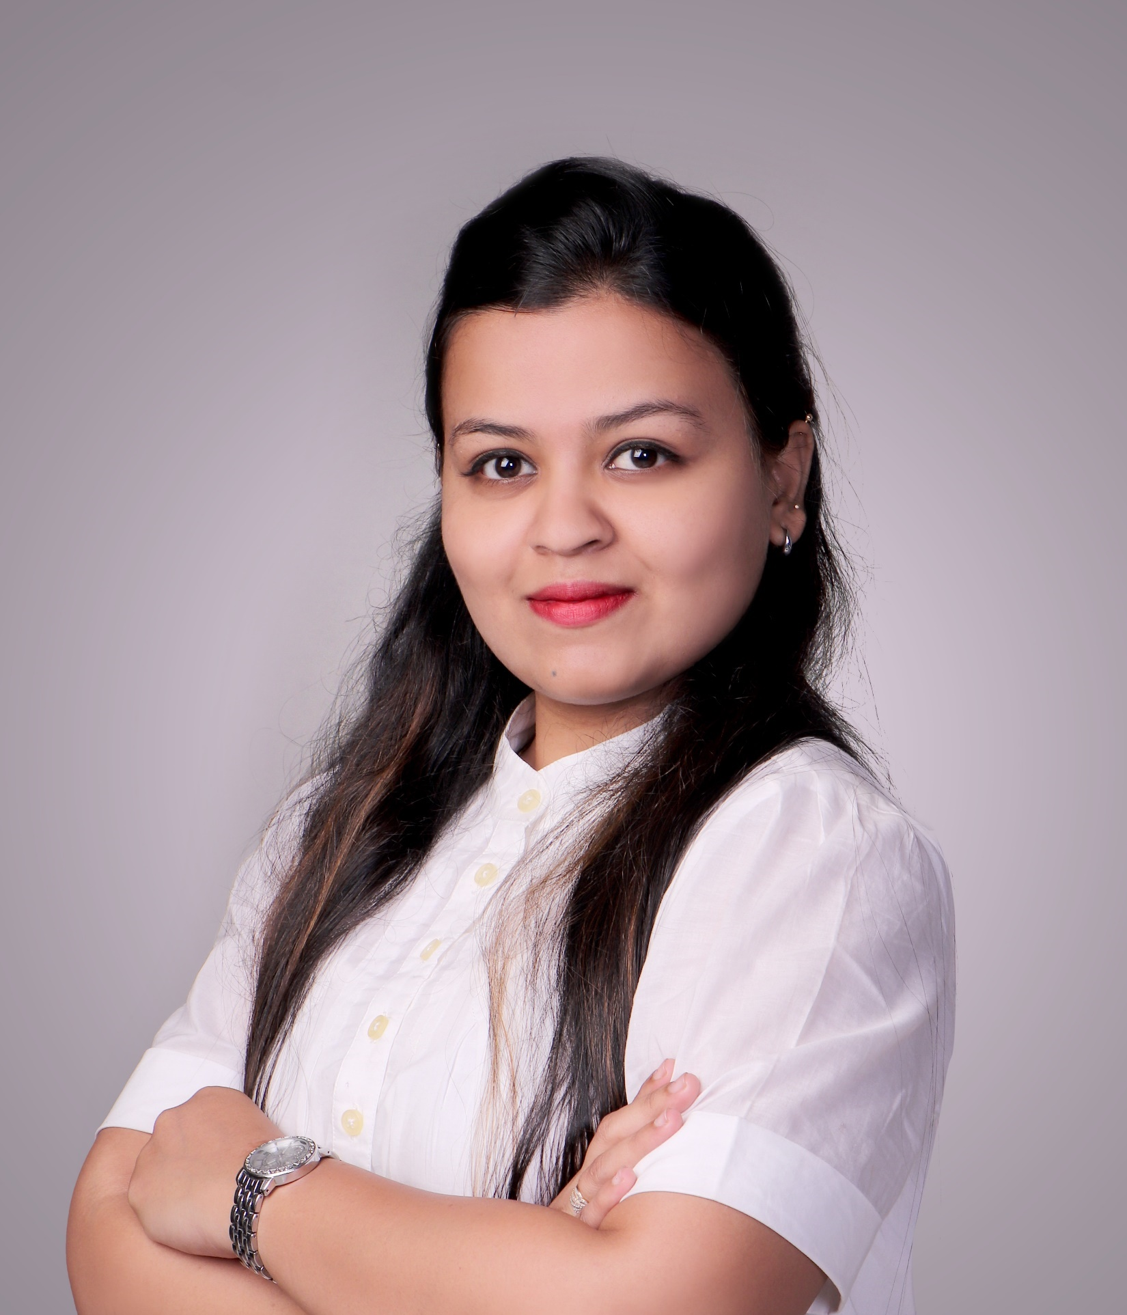
“ WINNERS DON’T DO DIFFERENT THINGS, THEY DO THE THINGS DIFFERENTLY ! ”
MARKETING & SALES EXPERTS
Professional experience :
Founder & MD of Omnipotent Industries Pvt.Ltd.
Founder & CEO at Krushstar Industry Pvt.Ltd.
General Manager at TikiTar Industry Baroda Pvt.Ltd. (South India)
General Manager at Southern Asphalt (Karnataka).
*MBA in Marketing & Finance
Mobile: +91 7795242424
E-Mail: princepshah@gmail.com
prince.omnipotent@gmail.com
Website: www.princeshah.com
www.omnipotent.co.in
Prince Shah
Managing Director
ORGANISATION STRENGTH
The personal &professional history of Mr. Prince Shah can be traced along the same path as the Omnipotent & Global Enterprises group, a organization that he has nurtured, grown and developed under his leadership for over 19 years.
The strength of organization depends on our professional & expertise staff. Currently we have 21 expertise staff in 6 different verticals with their professional experience in Marketing & Sales, Accounts, Data analysis, Legal, Exim & Logistics departments to managed & expand business in its professional manners. They are playing important role by execution of their various planning & business strategies to expand the organization strength and growth in Bitumen Industry.
IMPORT & EXPORT MANAGERS
INTERNATIONAL PURCHASE
& SALES MANAGER
ACCOUNTS & FINANCE EXPERTS
Driven by a strong passion to be a successful entrepreneur, Punit is a biotechnology engineer from VVP Engineering College (2005-09 Batch) and has been associated with distinct successful ventures in the areas of bio-services and engineering education.
Punit Popat
CEO of the company
AUDIT CONSULTANT
ADV. LEGAL ADVISOR
Punit has served as a founding member and executive director at various startups. With an objective to fast-pace already successful entrepreneurship career, Punit Popat joined hands with Mr. Prince P. Shah and Omnipotent in 2017, since then team has never looked back & together have scaled many milestones with the help of strong and dedicated passion driven team.
* Biotechnology Engineer
Mobile: +91 7795242424,
E-Mail: punit.omnipotent@gmail.com
Website: www.omnipotent.co.in

Slide 5

VISION & MISSION
We are here, “To give everyone, the power to create and achieve the reach instantly in Bitumen Industries, without barriers.”
“The Future cannot be predicted. It must be built upon our conscience, our own set of values, sense of right and wrong & the legacy we want to leave for future generation. The responsibility starts and ends with each of us as individuals.”
Our vision is the north star of an organization. We strongly believe to increase customer relationship & their reliability in this business. We are using innovative ideas & strategies. Our vision is to be the unique and no.1 into the Bitumen Industries. Our mission defines our organizational strength. We has professional staff, statics management and perfect planning to fulfill our missions.
Our Visions :
Customer oriented organization with rich numbers.
Market leaders to manage and control the Bitumen Industry.
To be the first in innovations in this industry
Hold the strongest company profile in Bitumen Industry
Our Missions :
Increase Import capacity on all the ports of India.
Increase number of customer base with their reliability.
Create Sales & base across the India.
Increase the number of Joint Ventures.

Slide 6

USP OF THE COMPANY
The company has been able to sell the Bitumen and Bituminous products at cheapest price in India.
Company has the track record of selling largest volumes at Pan India level.
The management of the company has been part of management of companies to consume 70% of the total imports taking place in India.
The Company comprise of wide team from Services industry to setting up manufacturing set up for bitumen, Sales head of top companies in Bitumen industry
Company has played major role in consuming the Bitumen from Imports and has worked with all players in the existing market to decide price of imports.
Company is into trading of Bitumen and Services for setting up the plant as well at the same time.

Slide 7
GROUP COMPANY
FINEXIC GROUP OF COMPANIES
FINANCIAL PARTNER
ADHIYA VENTURES INDIA PVT LTD
PETRO CHEMICAL, BIO FUEL & WASTE PLASTIC FUEL
SHUBHAM LIFE SCIENCE PVT LTD
ALL INNOVATIVE LIFE SCIENCE PRODUCTS FOR PERSONAL AND HEALTH CARE USE

Slide 8
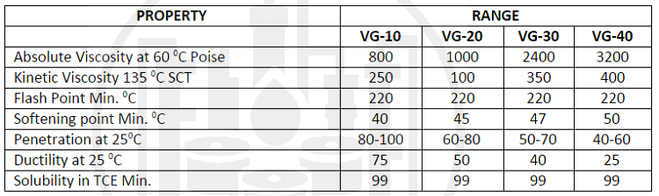
CATEGORIES OF BITUMEN
Different Grades of Bitumen marketed by Indian Oil :
VG-10 BITUMEN: VG-10 is widely used in spraying applications such as surface-dressing and paving in very cold climate in lieu of old 80/100 Penetration grade. It is also used to manufacture Bitumen Emulsion and Modified Bitumen products.
VG-20 BITUMEN: VG-20 is used for paving in cold climate & high-altitude regions.
VG-30 BITUMEN: VG-30 is primarily used to construct extra heavy-duty Bitumen pavements that need to endure substantial traffic loads. It can be used in lieu of 60/70 Penetration grade.
VG-40 BITUMEN: VG-40 is used in highly stressed areas such as intersections, near toll booths and truck parking lots in lieu of old 30/40 Penetration grade. Due to its higher viscosity, stiffer Bitumen mixes can be produced to improve resistance to shoving and other problems associated with higher temperature and heavy traffic loads.

Slide 9
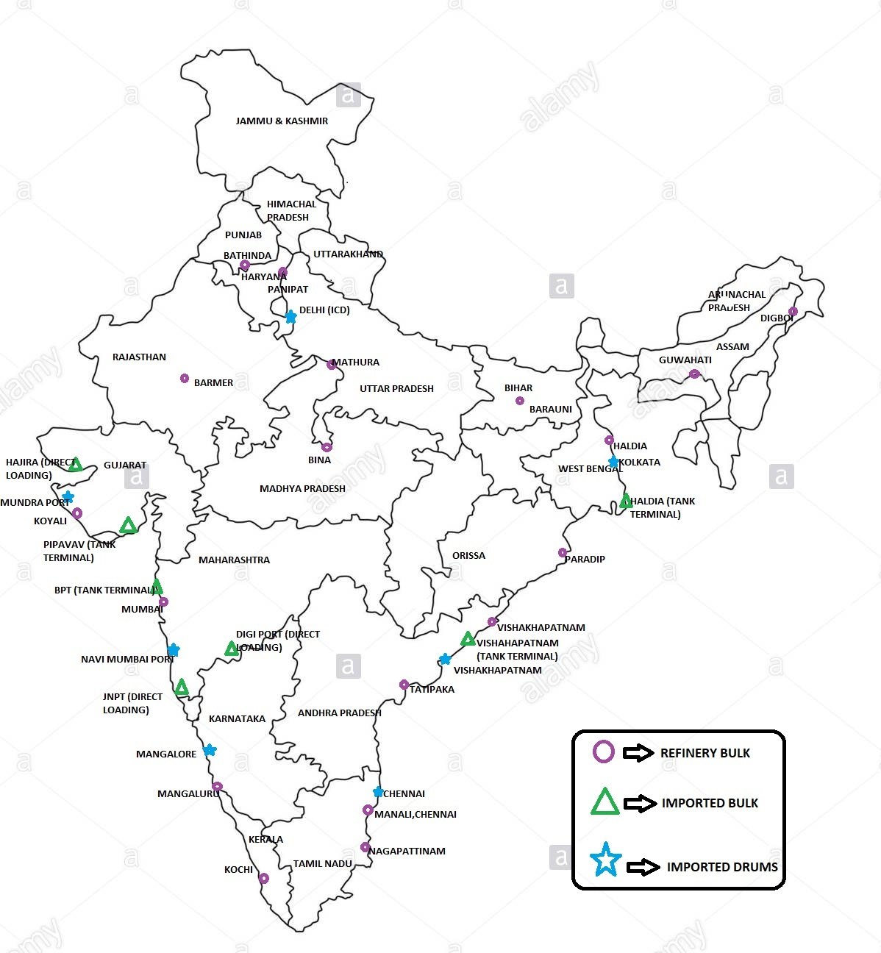
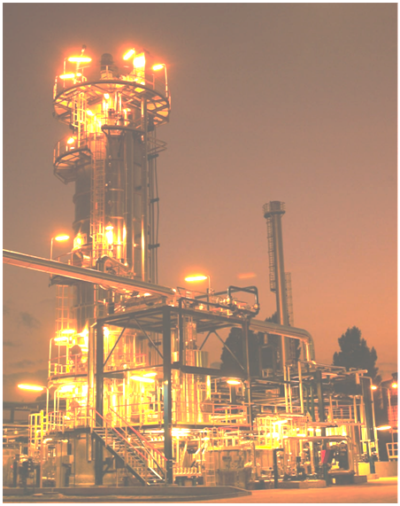
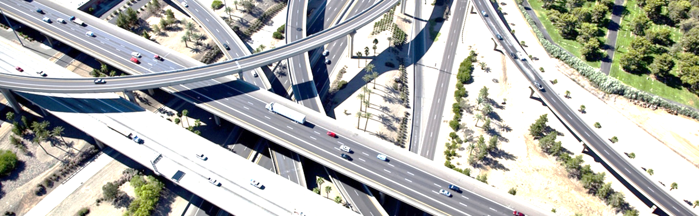
OUR PRODUCTS, SERVICES & SUPPLY
Mainly Omnipotent Industies Pvt Ltd. is entitle in this industry to import and sale the Bitumen and Bituminous products with make sure the availability of required material to our customers & for their reliability.
We sales Bitumen VG30 – 60/70 grades bitumen mainly in drums & in bulk. We also make available bitumen of other grades & bituminous products to our customers as per their requirement.
WE TRADE IN :
Import : 60/70 & 80/100
PSU in India : VG10, VG30, VG40
Emulsion as per IS - 8887:1995,
Emulsion as per IS - 8887:2004,
Emulsion as per ASTM – D244.
All Grades of Blown Bitumen : IS-7021-988 & IS-1203/1978
All Grades of Micro Surfacing Emulsion
Modified Bitumen : CRMB, PMB, NRMB.
FROM OUR JVS & JOB WORK LOCATIONS :
Bulk Bitumen Imported at :
Gujrat - Mundra
Gujrat – Pipavav
Maharashtra – Mumbai
Maharashtra – Dighi
Karnataka – Karwar
Karnataka – Mangalore
Drum Bitumen Imported at :
Gujrat – Mundra
Maharashtra – Mumbai
Karnataka – Mangalore
Tamilnadu – Chennai
PSU Bulk Bitumen from :
Gujrat – Vadodara
Maharashtra – Mumbai
Karnataka – Mangalore
Tamilnadu – Chennai
Telangana – Vishakhapattanam
Other Bituminous Products :
Karnataka – Belgum,Mangalore
Maharashtra – Mumbai, Nagpur
Telangana – Hyderabad
Gujrat – Baroda, Kutch

Slide 10
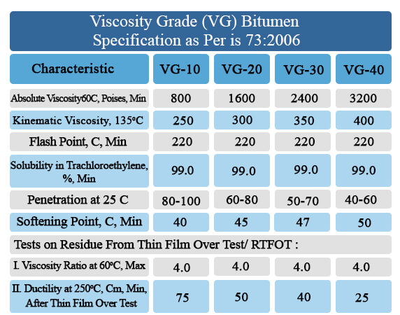
BITUMEN GRADE SPECIFICATION

Slide 11
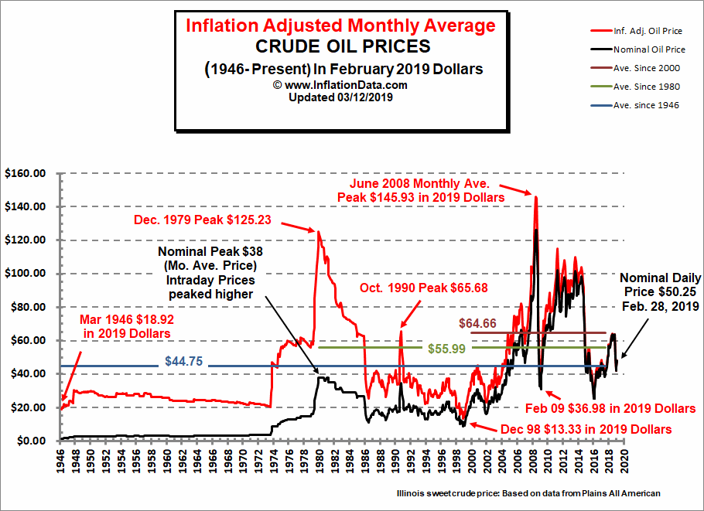

CRUDE OIL PRICE TREND

Slide 12
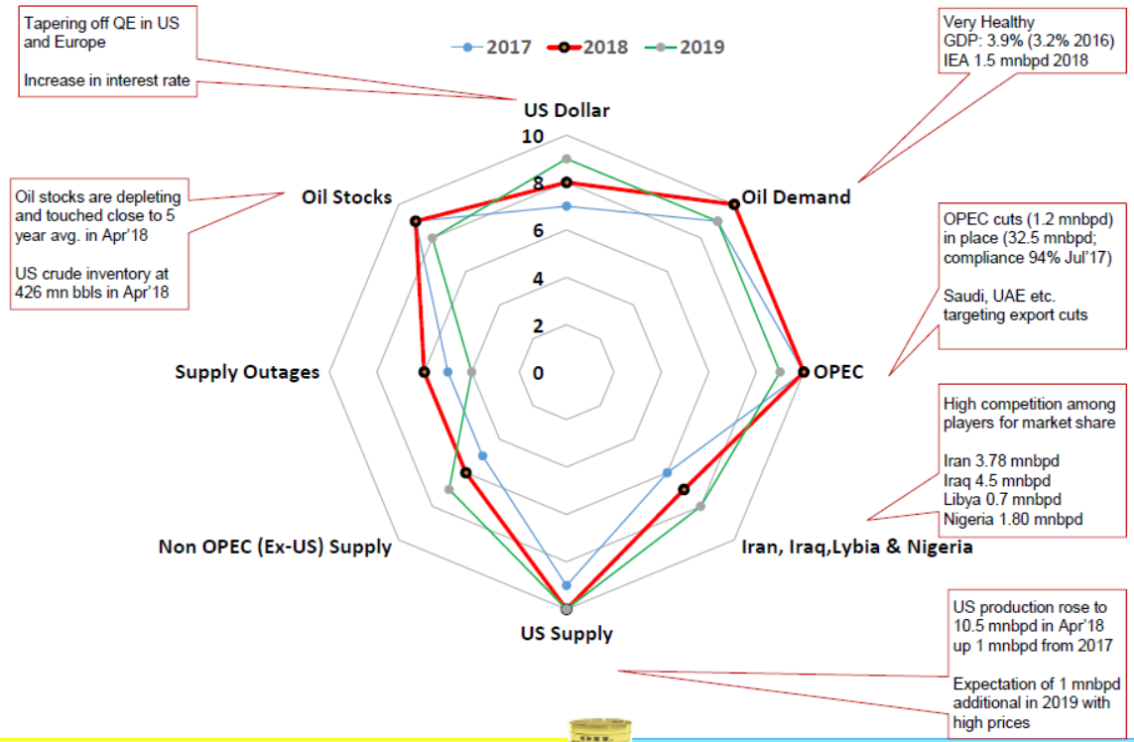
IMPACTS ON BITUMEN (WORLD ECONOMY)

Slide 13
Registered Office
Address : 1/11 Damji Nenshi Estate,
Station Road, Bhandup (West),
Mumbai – 400078.
Maharashtra, India.
Mobile No : +91 7400152424/ 9448281224
Telephone No : 022 21670182/183/184
Email Address : info@omnipotent.co.in
Website : www.omnipotent.co.in
www.princeshah.com
CIN No. : U74999MH2016PTC285902

